Slide 1
Class of 2018 senior information
Wednesday, October 12
6pm
RPHS Library
Susanna Jakubik

Slide 2
Class sponsor
Susanna Jakubik (susanna.jakubik@fortbendisd.com)
I teach yearbook, photography and broadcasting
Have sponsored the classes of 2013 and 2017
Am a 2018 mom to my daughter, Ryan
Looking forward to working with your kids!

Slide 3
agenda
Planned activities
Fundraising
How YOU can get involved

Slide 4
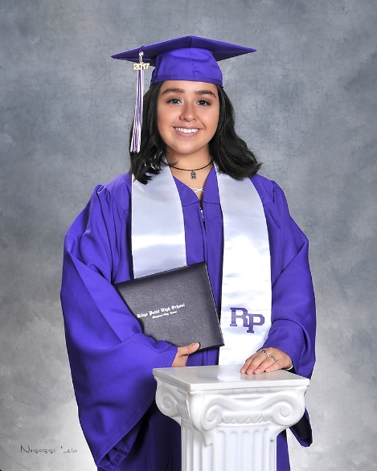
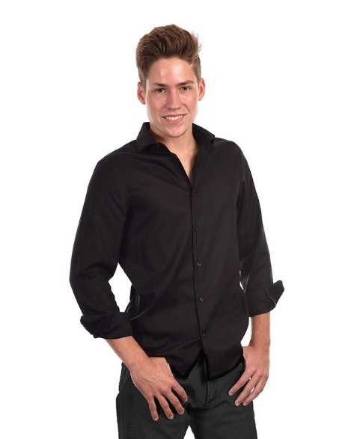
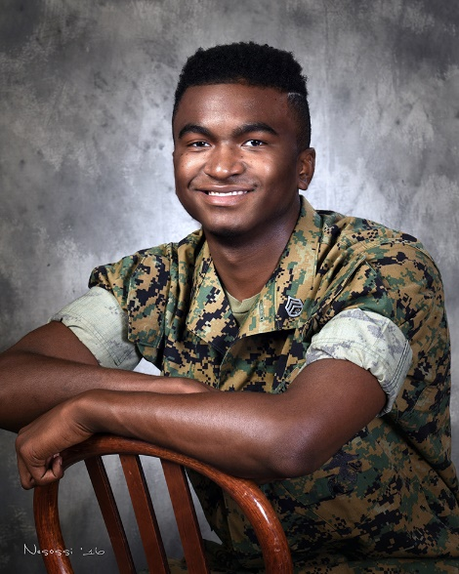
Senior pictures
August
Nesossi Studios will take senior photos on campus in August
Students will have choice of cap and gown, yearbook and/or “freestyle” photo
Yearbook photo will be in black on white and is free to take
Prices vary

Slide 5
Senior t-shirt
August
Students will select design for senior t-shirt
Will be included in Senior Package ($16)
Will be required to attend Senior Scram

Slide 6
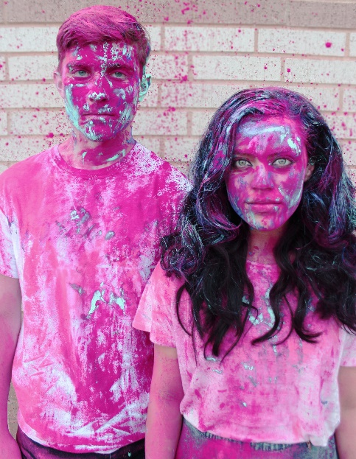
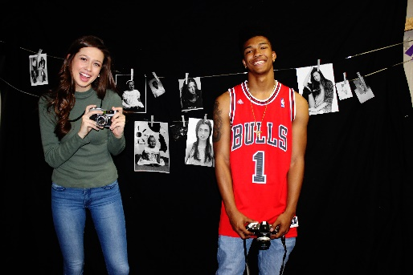
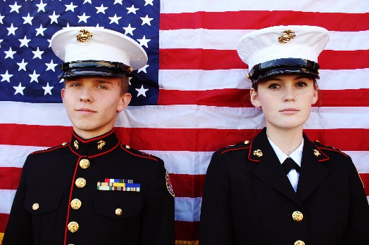
Senior awards
September
Seniors vote on one girl and one guy in categories such as:
Most Likely to Join the Military
Most Artistic
Most School Spirit
Winners will be featured in 2017-18 yearbook

Slide 7
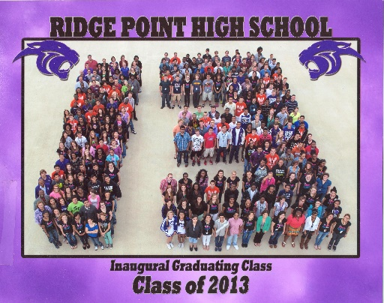
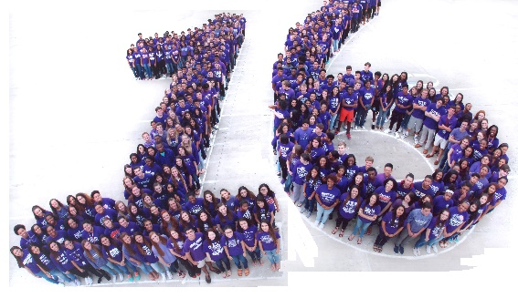
Senior group pic
April
Entire class featured in panoramic photo and “18” photo
Taken during school hours
Will be included in Senior Package ($40)

Slide 8
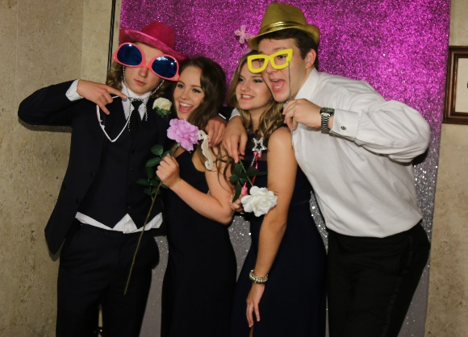
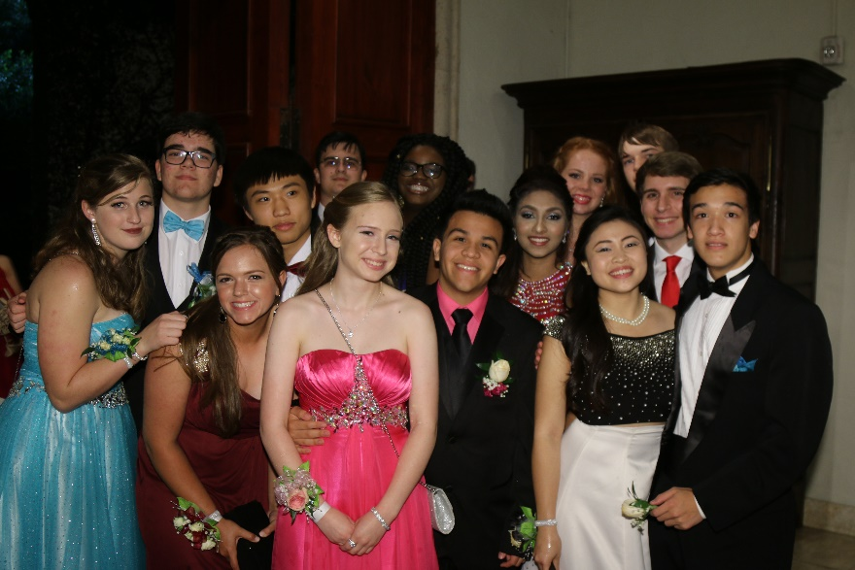
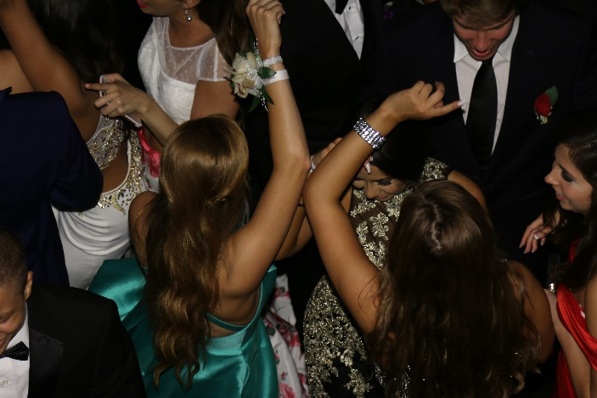
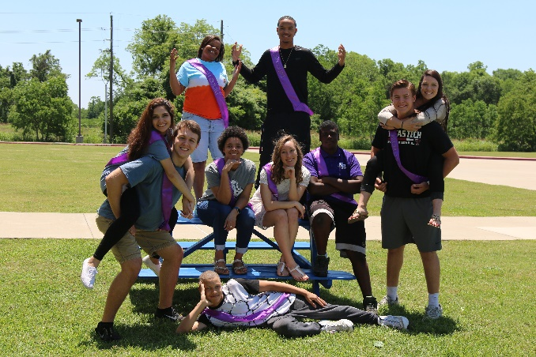
prom
May
May 5, 2018 for seniors and guests only
Selecting venue at end of month
Will be included in Senior Package ($140)

Slide 9
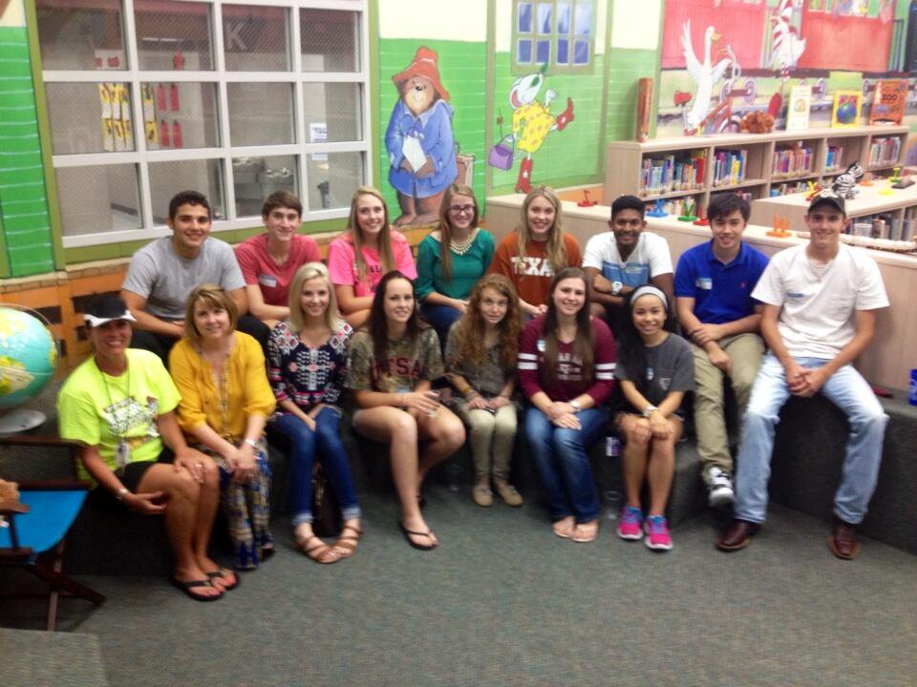
Elementary receptions
May
Some feeder elementaries host receptions for former students who are graduating
Scanlan Oaks and Sienna Crossing

Slide 10
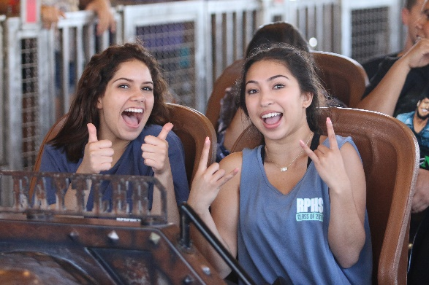
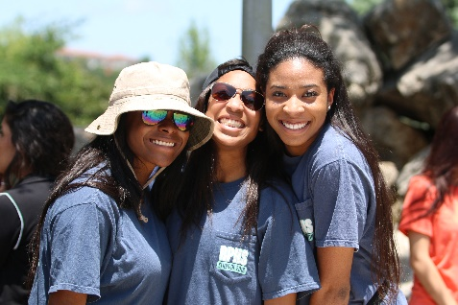
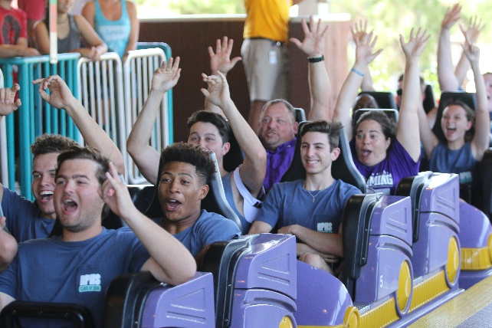
Senior Scram
May
Day trip on coach buses to Fiesta Texas
Location already selected
Date TBD, but is end of May
Will be included in Senior Package ($90)

Slide 11
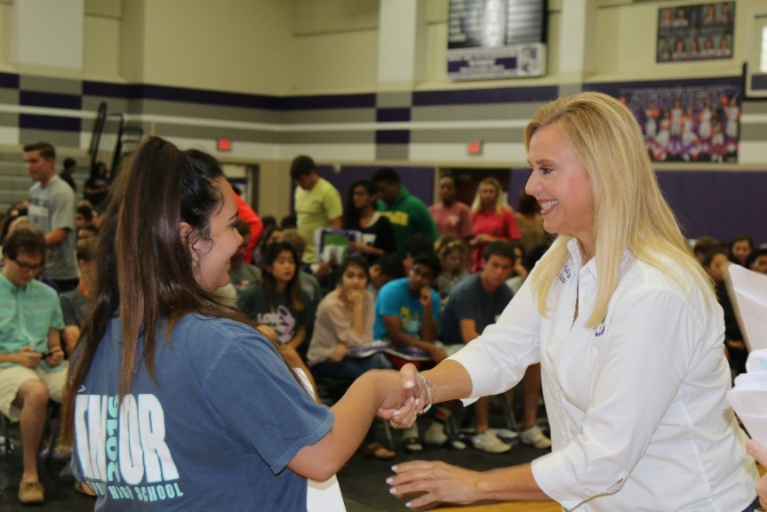
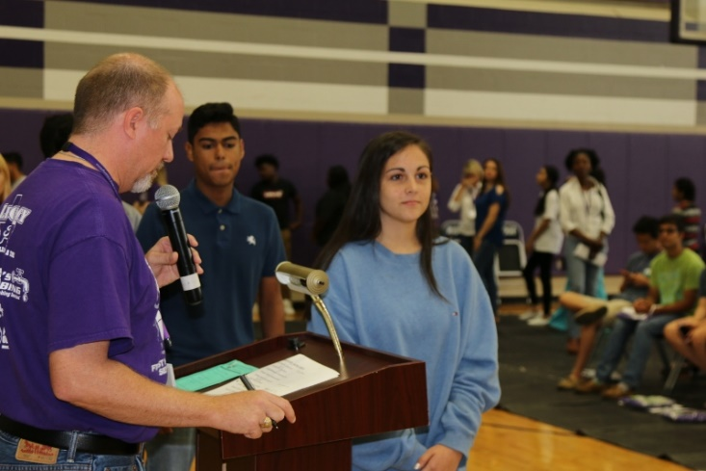
Graduation rehearsal
May
Mandatory for all seniors
In RPHS large gym during class day
Caps and gowns will be distributed ($50)
Will be ordered through Balfour in May
Held week before graduation

Slide 12
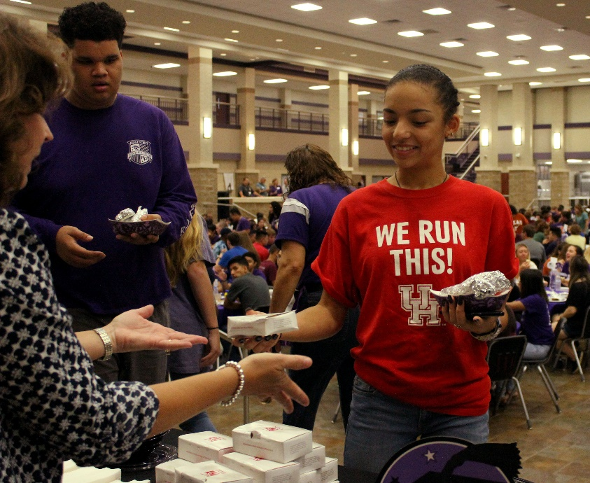
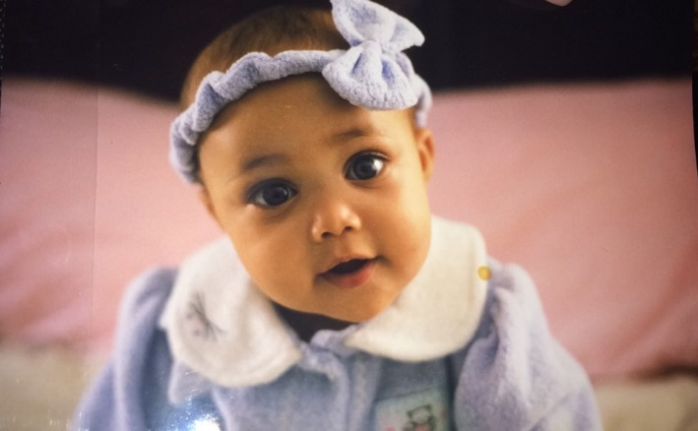
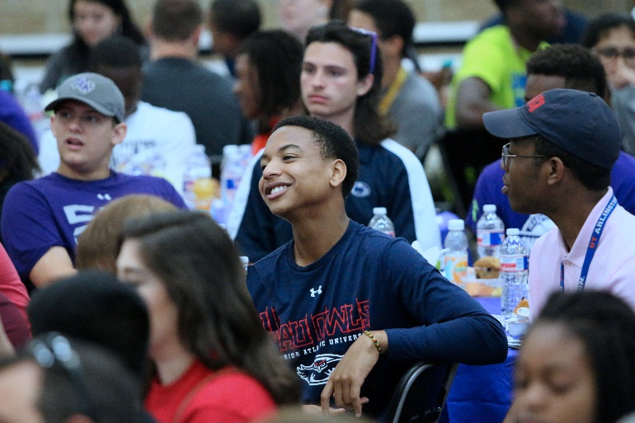
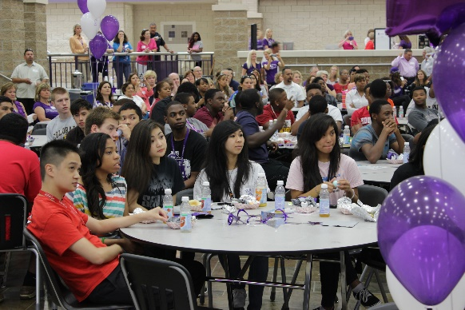
Senior breakfast
May
Breakfast honoring seniors in RPHS Commons
Senior video is shown
May 31, 2018
Will be included in Senior Package ($10)

Slide 13
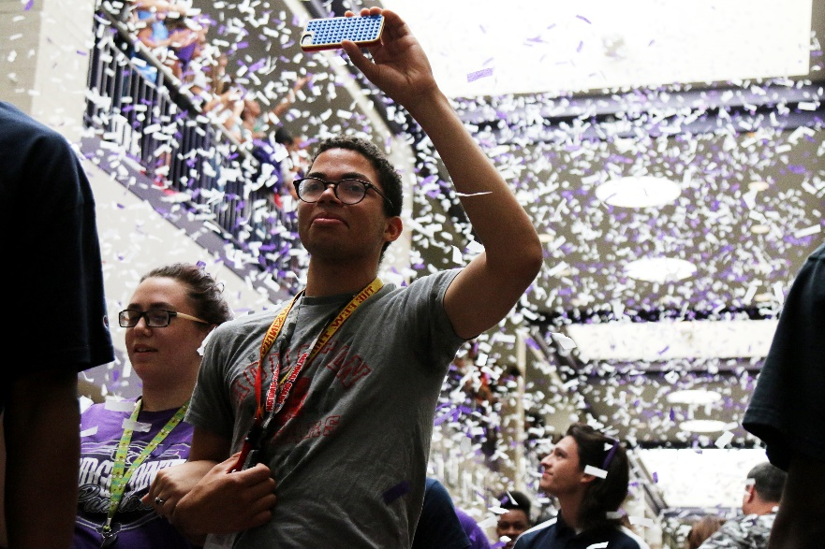
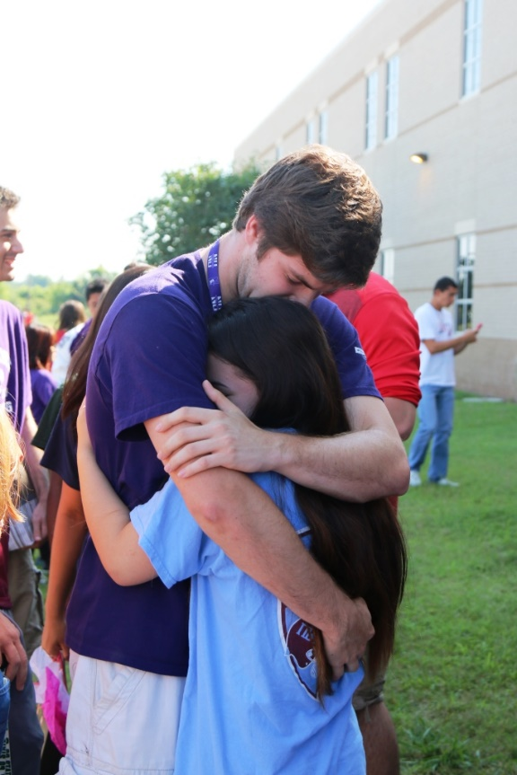
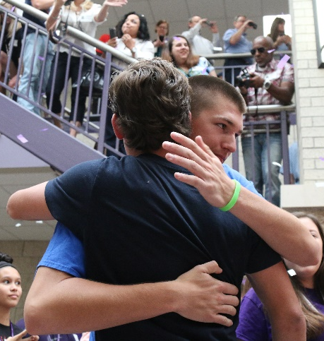
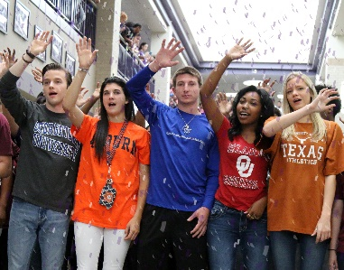
Last walk
May
One final walk down Main Street, lined with the entire school, parents and families
School song echoes in the hallways and confetti cannons shower grads with purple, silver and white
Immediately following Senior Breakfast

Slide 14
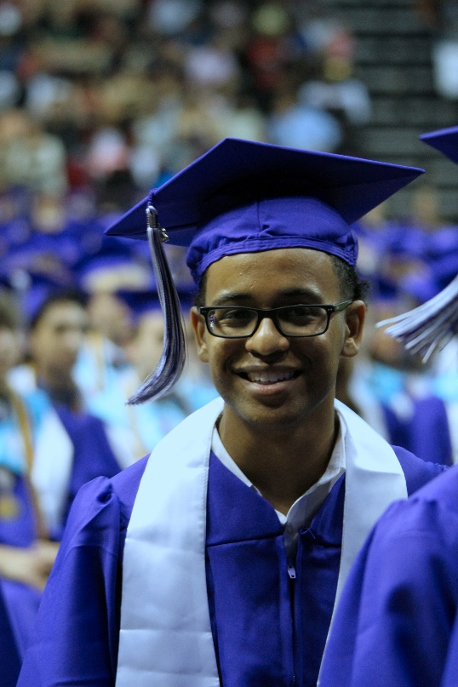
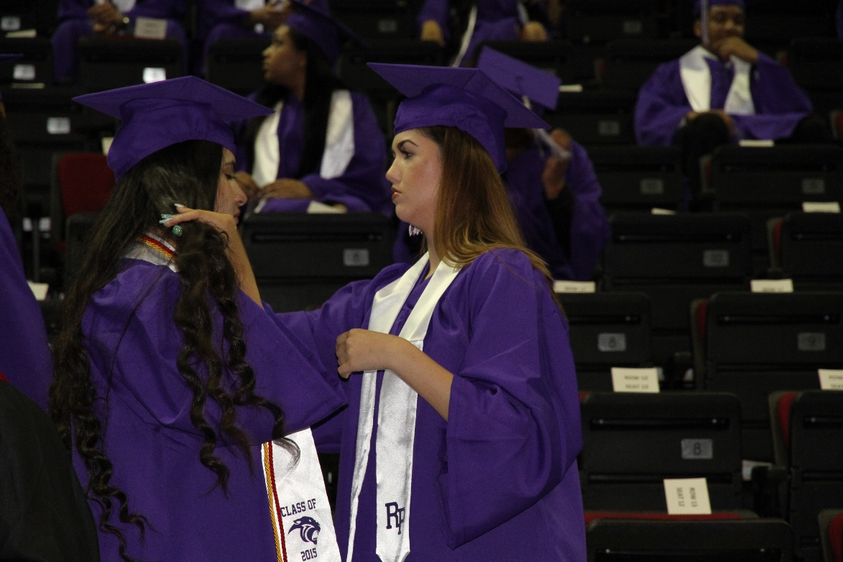
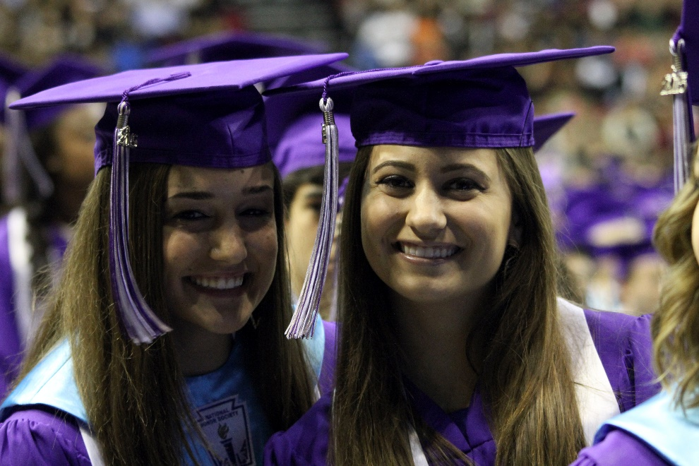
Graduation
June
June 1 OR 2, 2018
Will last two hours
Location TBD

Slide 15
yearbook
August
Will deliver in August, 2018
Will be included in Senior Package AND will be shipped to home address on file ($85)
Optional name stamping ($10) and senior shout-out ads ($25) will be offered in Senior Package signup

Slide 16
How do we pay for all of this?

Slide 17
Senior package
Allows many senior expenses to be paid over time
Price is $365
Has been between $360 and $365 for past three years
Includes the following items:
T-shirt
Class photo
Prom
Senior Yearbook
Senior Scram
Senior Package not mandatory to participate in senior activities
All items available a la carte
Will offer in spring with first payment due March 25, 2016

Slide 18
fundraising
Events versus another candle or gift wrap
Color Run; take over from Key Club?
Sponsorships

Slide 19
How can you help?
Prom
Decorating, food and beverage planning, logistics
Senior Breakfast
Decorating, logistics
Fundraising
Planning, implementing, logistics
Please sign up on the sheet that’s going around or email me to volunteer

Slide 20
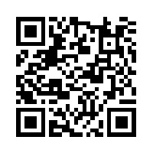
communications
Everything you need is on theProwler
Up to date event information
Sign up for weekly emails
Contact information
Scan the qr code to visit the website

Slide 21
Thank you
Your senior will thank you too!

